Slide 1


Code of Conduct:
I Shaik mahamad sohail (192511120) certify that this submission is my original work and
that I have adhered to the guidelines specified for this assessment.
I understand that any violation of academic integrity rules will result in disciplinary action.
Signature of the student:

Slide 2
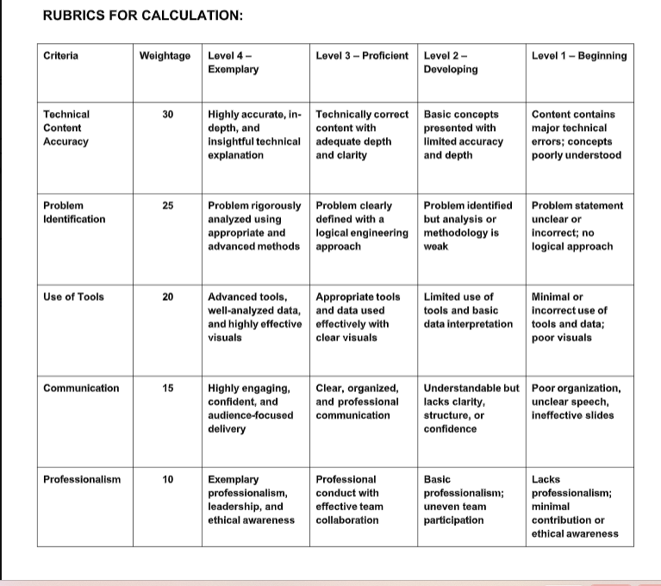

Slide 3


Technical Presentation
CSA 0302 – DATA STRUCTURES
Co1 AT – 2
Presented by :
sohail(192511120)

Slide 4
1.Data Structure Recommendation for Dynamic Playlist Management
Recommended Data Structure: Doubly Linked List
A Doubly Linked List is the most suitable data structure for managing a dynamic playlist in a music streaming application because it provides excellent flexibility and efficient insertion, deletion, and reordering of songs.
Justification
Dynamic Insertion: New songs can be added at the beginning, end, or any position without shifting other elements.
Efficient Deletion: Songs can be removed quickly by updating the previous and next links.
Easy Reordering: Songs can be moved to different positions by changing links instead of copying data.

Slide 5
Requirements
Playlist Operations
Add a song
Remove a song
Move songs to different positions
Traverse songs sequentially
Support dynamic playlist size

Slide 6
Comparision
Data Structure | Advantages | Disadvantages
Array | Fast indexing | Costly insertion and deletion
Stack | Simple Last-In-First-Out | Not suitable for playlists
Queue | First-In-First-Out | Cannot reorder songs
Linked List | Dynamic, flexible insertion and deletion | Slightly slower random access

Slide 7
Conclusion
Recommendation
A Linked List is the most suitable data structure for playlist management because it:
Supports dynamic updates
Allows efficient insertion and deletion
Makes song reordering simple
Uses memory efficiently
Final Recommendation: Linked List is the best choice for flexibility and efficiency in dynamic music playlists.

Slide 8
2. Suitable Data Structure for Metro Rail Network Representation
A Graph is the most suitable data structure for representing a metro rail network because it naturally models stations as vertices (nodes) and routes between stations as edges (connections).
Stations as Vertices: Each metro station is represented as a node.
Routes as Edges: Direct rail connections between stations are represented as edges.
Efficient Reachability: Algorithms such as Breadth-First Search (BFS) or Depth-First Search (DFS) can find all reachable stations from a source station.

Slide 9
Time Complexity
Operation | Time Complexity
Add Station | O(1)
Add Route | O(1)
Remove Route | O(1)
Traverse Network (BFS/DFS) | O(V + E)
Search Reachable Stations | O(V + E)
Where V is the number of stations (vertices) and E is the number of routes (edges).

Slide 10
Applications
Metro rail route planning
Google Maps navigation
Railway reservation systems
Flight route networks
Road transportation systems

Slide 11
Conclusion
A Graph implemented using an Adjacency List is the best data structure for representing a metro rail network because it:
Efficiently models stations and routes.
Supports fast reachability analysis using BFS or DFS.
Allows easy addition and removal of stations or routes.
Uses memory efficiently for large transportation networks.

